Slide 1
How to use the Copilot PowerPoint Starter Template

Slide 2

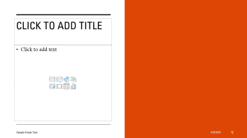
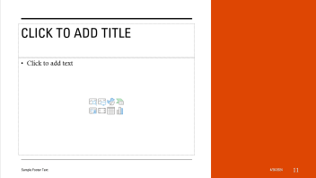
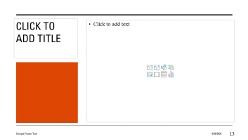
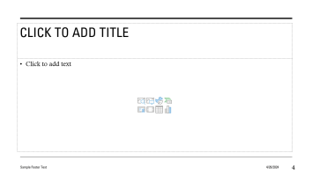
Key Requirement | Copilot needs different sizes of placeholders to support a large range of text content length
XS
S
M
XS
S
M
L
XL
L
XL

Slide 3
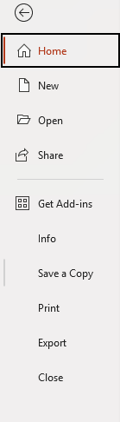

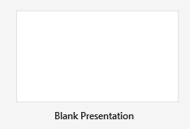
ONE : Open an existing template or create a new one
Step 1 | Select the File tab from the ribbon
Step 2 | Click New
Step 3 | Open either an existing template or choose Blank Presentation

Slide 4
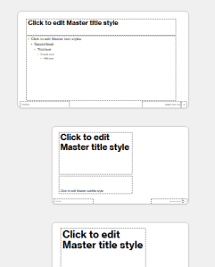
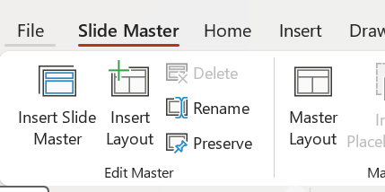
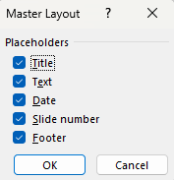
TWO : Double check your Slide Master is set up correctly
Step 1 | Open Slide Master view from the View tab in the ribbon
Step 2 | Select the Slide Master thumbnail
Step 3 | Click the Master Layout button in the ribbon
Step 4 | Select all the placeholder types

Slide 5
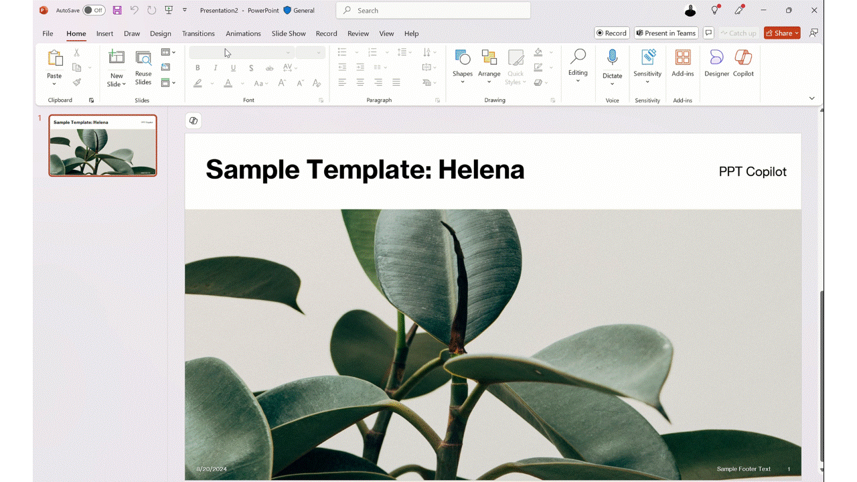
THREE : Copy and Paste Starter Template Layouts (Video)
Copy and paste the layouts in this starter template into your new or existing template

Slide 6
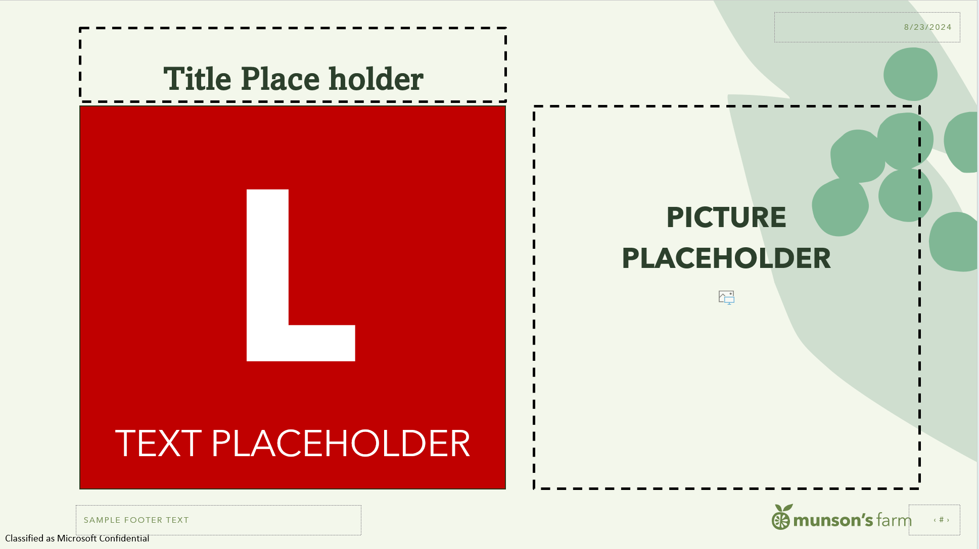

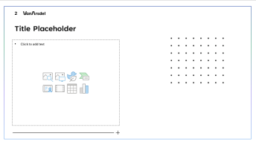
FOUR : Customize the starter layouts
Add branding, design elements or additional placeholders keeping the approximate size of the starter content placeholders the same.
L
L
L
Placeholders for pictures
Style and design elements around and behind other placeholders
Purely decorative elements outside of placeholders

Slide 7


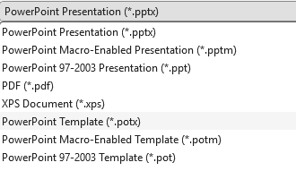
FIVE : Save your file as a PowerPoint Template
Step 1 | Select the File tab from the ribbon
Step 2 | Click Save As or Save a Copy
Step 3 | Choose .potx from the save as type list
Step 4 | Rename your template
Step 5 | Click the save button

Slide 8
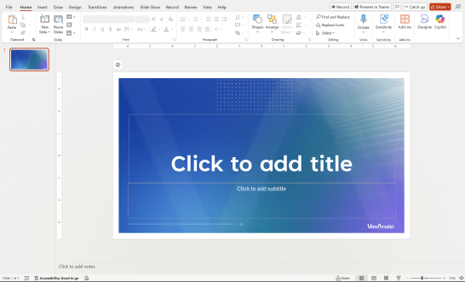
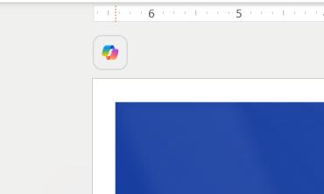
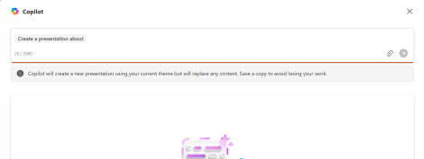
SIX : Be sure to test your template with Copilot
Step 1 | Open your template in PowerPoint
Step 2 | Click the Copilot icon in the top left corner and choose “Replace with new presentation”
Step 3 | Use Narrative Builder to
create a presentation

Slide 9
Additional Resources
Create and save a PowerPoint template – Microsoft Support
Keep your presentation on-brand with Copilot – Microsoft Support
Creating custom templates that work well with Designer in PowerPoint – Microsoft Support
Copilot in PowerPoint Learning

